Slide 1
Linguistically-swimming course
Lívia Knuthová
6.C

Slide 2
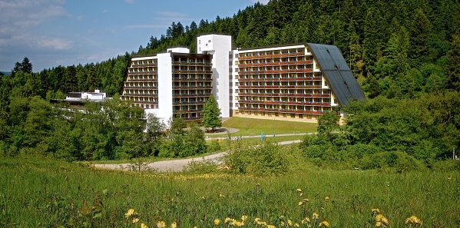
Stará Ľubovňa
Hotel SOREA

Slide 3
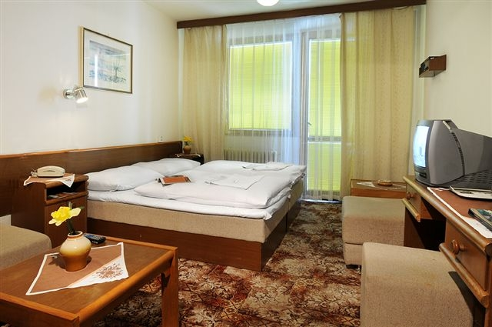
Our rooms
6.C and 6.B were accomodated on 2nd floor
6.A was on 5th floor.

Slide 4
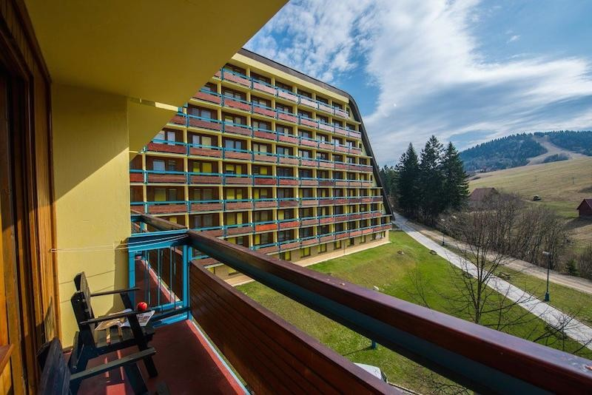
Beautiful nature around the hotel

Slide 5
Schedule
We got up at 7:15 and than we had breakfast at 8:00 a.m.
At 9:00 6.A went to swim into the swimming pool . 6.C and 6.B had English lessons.
At 10:00 we had snack.
At 12:00 we had lunch.
From 12:30 to 14:00 we had free time.

Slide 6
Schedule
At 15:00 boys and girls went in fitness centrum.
At 16:00 we had tea time.
At 18:00 we had supper.
Evening programme
We went to bed at 21:00.

Slide 7
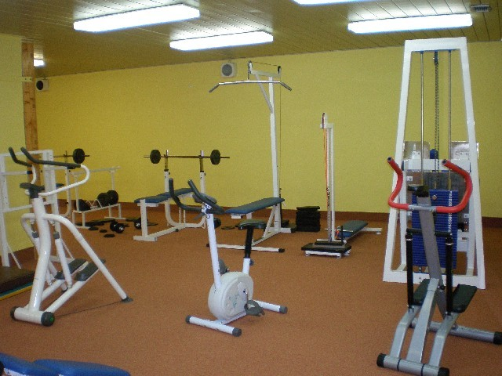
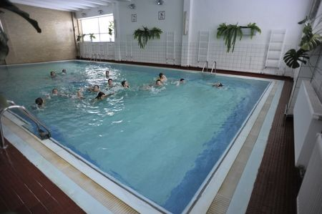
Swimming pool,fitness

Slide 8
Our teachers
Mrs.Magdziaková and Mrs.Chovancová taught English .
Mrs.Milá and Mr.Ferík taught swimming.
They were perfect.

Slide 9
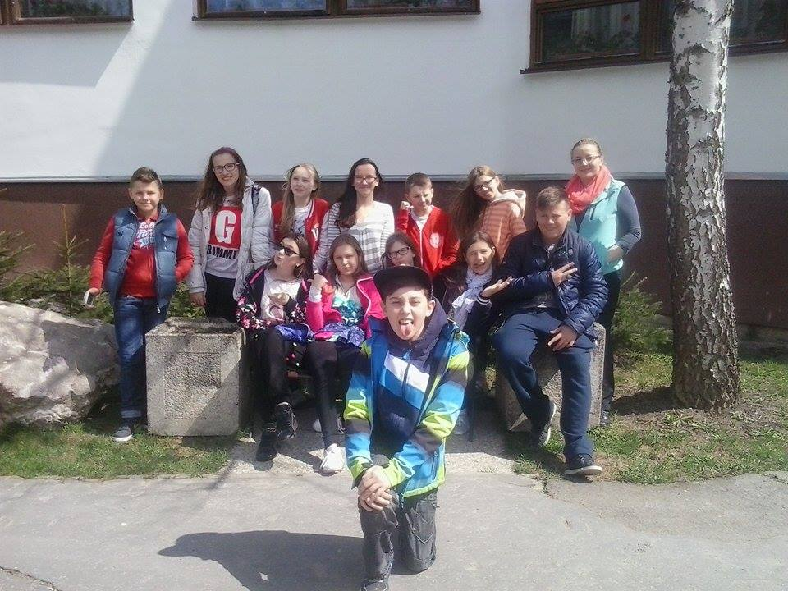
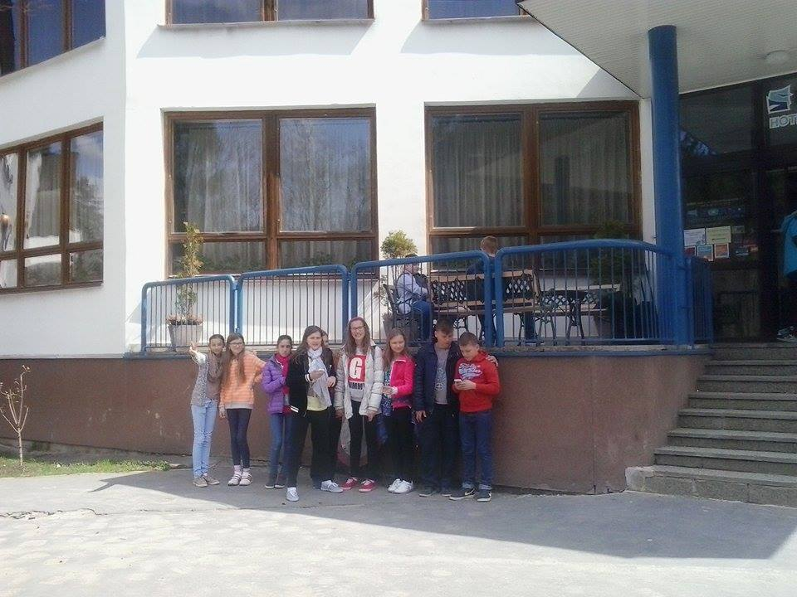
Last days
On Thursday we had great disco.On Friday we went home .We were very sad,it was fantastic course.

